Slide 1




ATHENA
COURSE RECOMMENDATION SYSTEM
Anmol Mittal - 221059688
Divyansh Gupta - 221297213
Duanrui Liu - 217409418
Priya Chaudhuri - 221060736
Sanya Kapoor - 221740519
Group 15

Slide 2




AGENDA
A Roadmap for the Athena Course Recommendation System Presentation
01
The Problem
05
Market Analysis
02
The Solution
06
Business Case
03
Idea Overview
07
Implementation Plan
04
Backend and Frontend
08
Future Enhancements

Slide 3







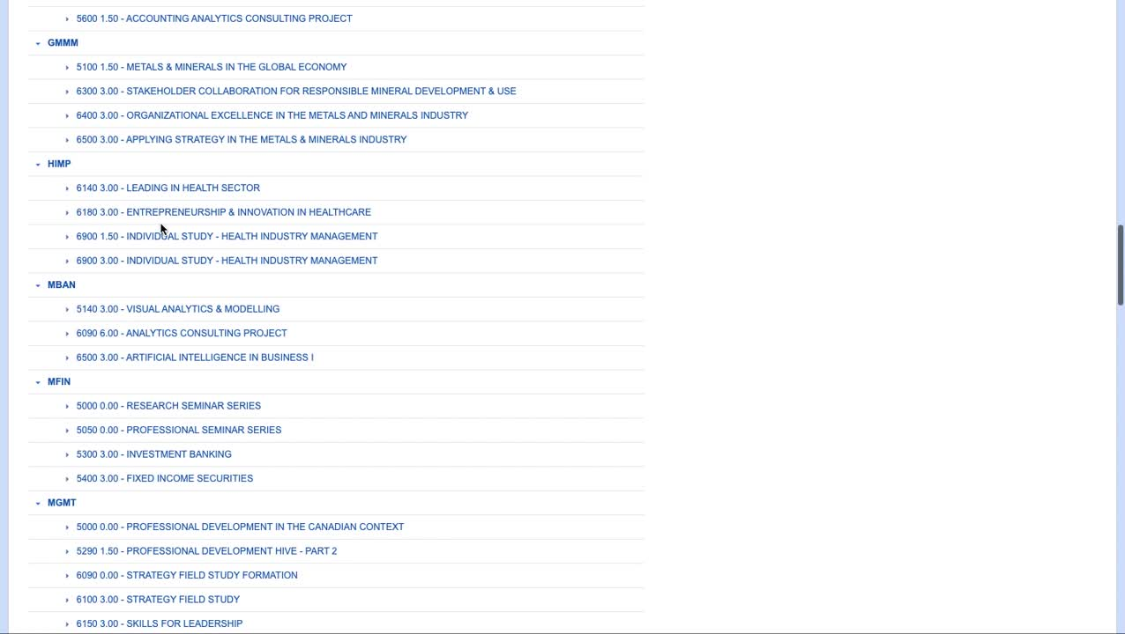



CAN YOU RELATE?
WHY ARE WE HERE TODAY?
Oh No! I haven’t decided on my course choices yet and the deadline is in a week!!!!
Now I have to go through the whole catalog to find the electives I ACTUALLY like!
But I also wanted to look into something a little more technical.
Have you ever struggled to choose electives?
I’ve heard really good feedbacks about the Service Marketing Course
But then I also looked in the entrepreneurship course and felt it would help me with my career goals!
How many of you have still not finalized your course choices?
01

Slide 4



THE SOLUTION
The prototype has been linked here.
02

Slide 5








IDEA OVERVIEW
Personalized recommendation system - help students easily find elective courses..
Aligns course choices with academic interests, career goals, and personal preferences.
Provides tailored course suggestions, simplifying the traditionally complex and overwhelming course selection process.
Empower students to make informed, goal-oriented decisions about their academic paths.
User Course Interest
Athena
Course List
User Course Recommendation
Content Based Filtering
How it works
Why It Matters
Data Inputs: Course descriptions, credits, program areas, etc.
Algorithm: TF-IDF for course descriptions, cosine similarity for course matching.
UI: Search and select courses; get recommendations based on similarity.
Scalability: Handles over 300 courses with potential for expansion.
For Students: Personalized, accurate course recommendations that align with academic goals.
For the University: Increased student satisfaction, engagement because of reduced decision fatigue.
For Faculty: Better understanding of course demand.
03

Slide 6
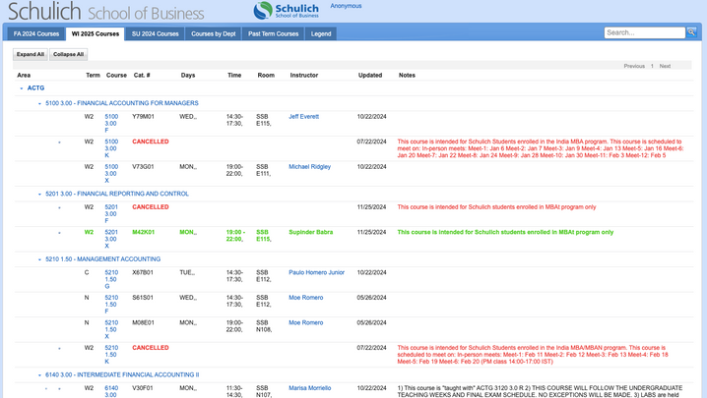

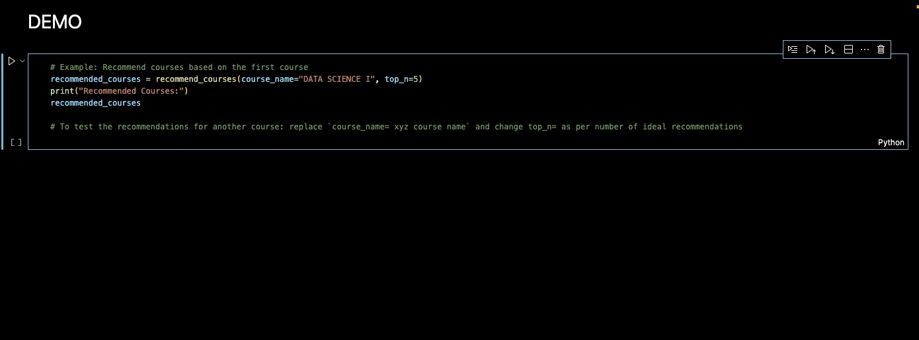
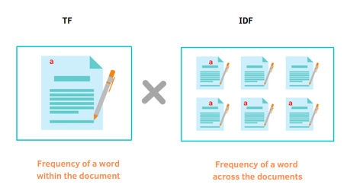
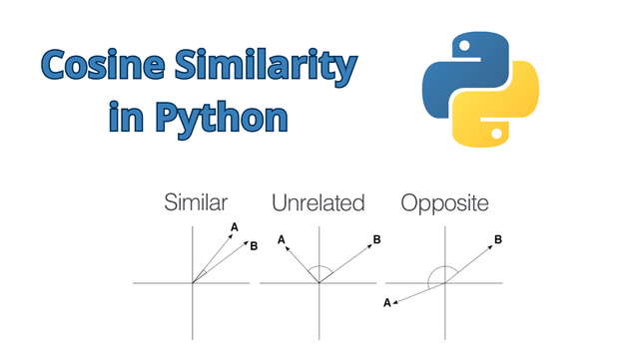

BACK-END DEVELOPMENT
Data Source
Code
Interface
Text Standardization
Text Vectorization
From the Schulich School of Business course catalog.
Textual, Categorical, and Numerical data.
Accurate, and reliable, coming from an official course catalog.
Missing descriptions are filled with empty strings, and course names are standardized (uppercase).
Text Relevance
04

Slide 7
FRONT-END DEVELOPMENT
Overview
Interface
The frontend of the Athena Course Recommendation System is designed to provide an intuitive, visually appealing, and user-friendly experience for students.
Technologies Used:
HTML: Structured the layout and content of the interface.
CSS: Styled the website to ensure a cohesive and professional look, enhancing user engagement.
JavaScript: Enabled interactivity, such as course search functionality and dynamic updates for recommendations.
Features:
Responsive Design: Optimized for devices of all sizes (mobile, tablet, and desktop).
Interactive Search Bar: Allows students to type course keywords and view tailored recommendations.
User-Centric Interface: Clear navigation and personalized recommendation display aligned with academic preferences.
04

Slide 8





01
Industry Overview
The global EdTech market is projected to grow from USD 298.5 billion in 2023 to USD 911.9 billion by 2030.
[Source]
MARKET ANALYSIS
Trends
02
Rising demand for personalized digital learning tools
Digital Transformation in Education sector to enhance engagement and streamline decision-making
03
Role in the Educational Landscape
Personalized, Data-Driven and Student-Centered AI-driven Recommendations aligning with industry trends
Can be implemented across other colleges.
05

Slide 9






BUSINESS CASE
3
Initial Development Costs
Annual Operational Costs
Revenue Potential
Year 1
Revenue Potential
by Year 3
Model Training & Optimization
$15,000
Data Pipeline Setup
$10,000
Backend Infrastructure $20,000
Cloud Hosting (AWS/GCP)
$5,000
Maintenance & Updates
$10,000
Annual Subscription Fee
$10,000 per institution
Target Clients
University Admins
Revenue
$500,000
Potential to gain upto 200 universities onboard as clients generating upto $2M in revenue.
Profitability
With a break-even point achievable within the first year, the model ensures strong margins. Expanding features (e.g., user reviews, and interactive dashboards) can unlock additional revenue streams.
06

Slide 10







IMPLEMENTATION PLAN
Key Milestones
1.
2.
3.
Month 1–3: Finalize prototype and secure initial pilot partners.
Month 4–6: Deploy pilot systems and gather feedback.
Month 7–12: Launch SaaS platform with 5-8 paying institutions.
Year 2: Expand to 50+ institutions and introduce premium features.
Development
Phase
Operational
Phase
Growth/Scaling
Phase
Model Development
Data Integration
Building Prototype
SaaS setup
Testing & Deployment
Training & Support
Client Onboarding
Feature Expansion
Global Expansion
07

Slide 11











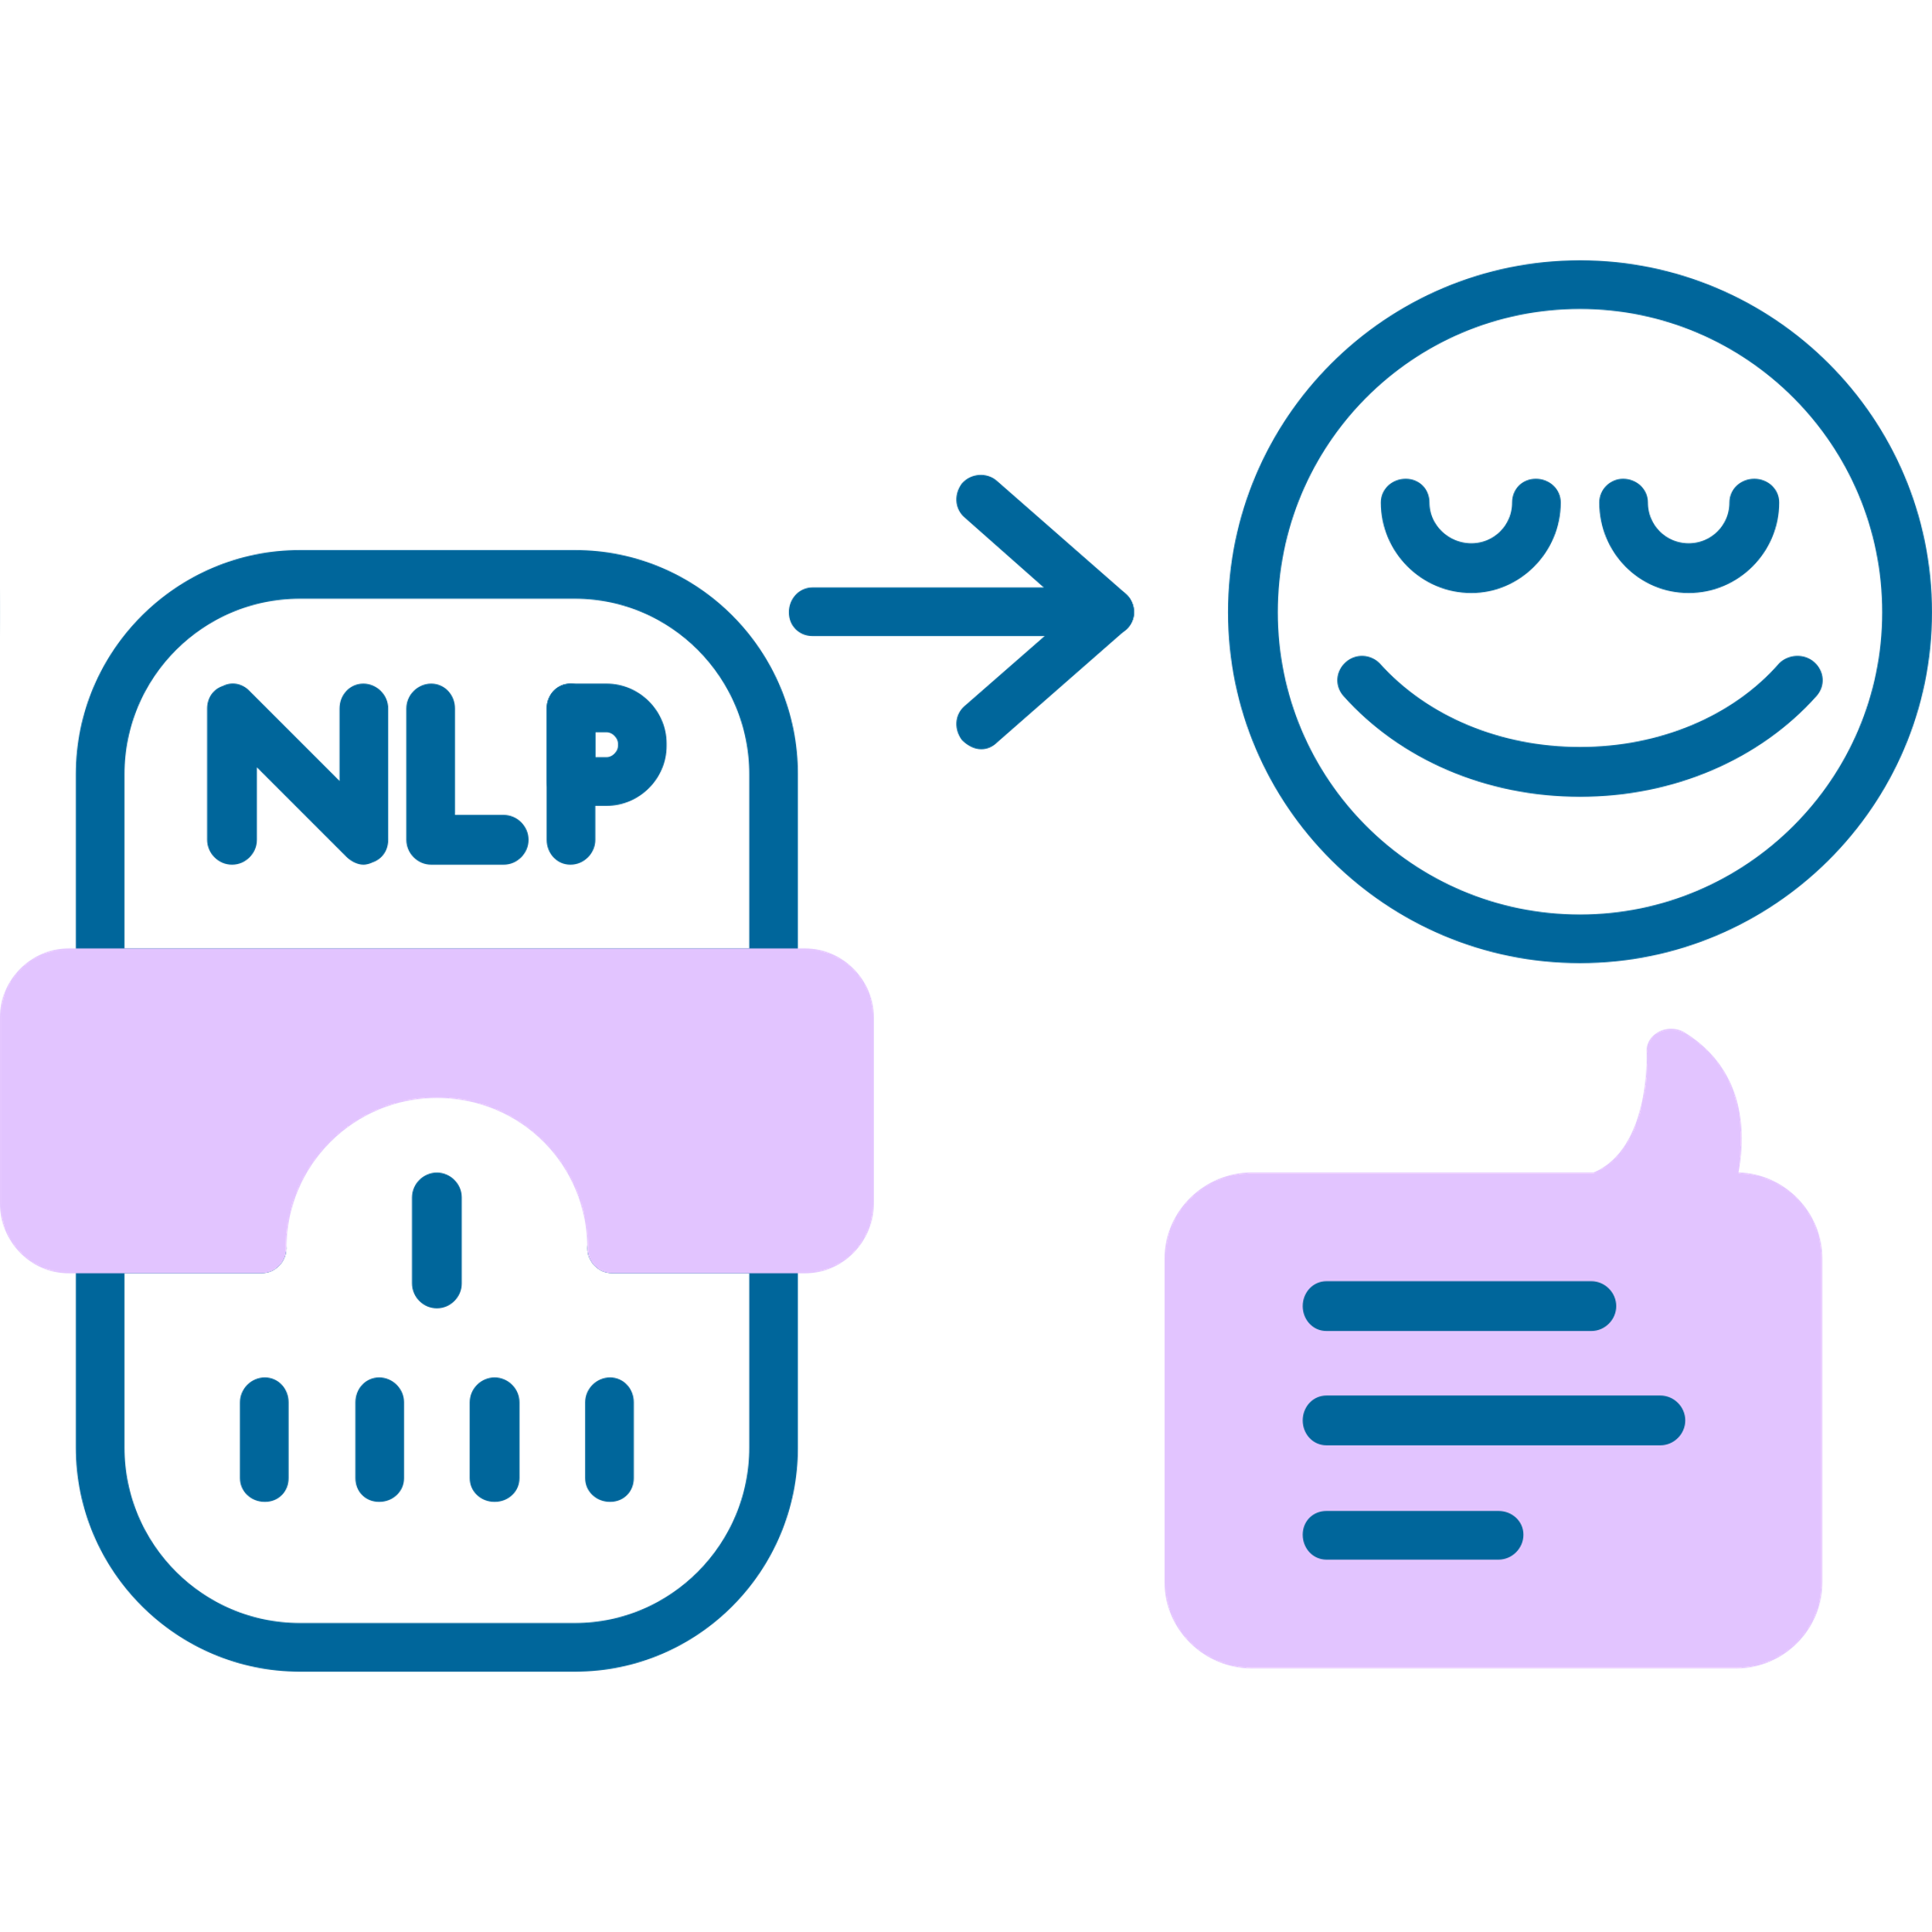
FUTURE ENHANCEMENTS
User Course Interest
Hybrid Filtering: Integrating collaborative and content-based filtering to offer even more personalized course recommendations based on user behavior and peer choices.
01
Course Interest
(both users)
Athena
Course List
Similar Users
Athena
Course List
Course Selected
by User1
Recommended
to User2
User Course Recommendation
Content Based Filtering
Collaborative Filtering
02
Scalability & Customization: Expanding the system to include customizable features for different universities, such as course prerequisites, faculty reviews, and career path alignment.
User Feedback Integration: Allowing students to rate or review recommendations, would provide valuable data for refining the recommendation engine and further personalizing suggestions.
03
Advanced NLP Models: Incorporating BERT or similar advanced natural language processing models to enhance the semantic understanding of course descriptions or textual reviews, improving recommendation accuracy.
04
08

Slide 12


CONCLUSION
"Knowledge is power, but wisdom is choosing the right path to apply it."
Athena empowers students to make informed, personalized course decisions aligned with their goals.
Simplifies course selection, transforming complexity into clarity and confidence.
Benefits for all stakeholders:
Students: Tailored recommendations to achieve their aspirations.
Universities: Enhanced satisfaction and data-driven insights.
Faculty: Improved understanding of course demand and interests.
Athena lights the way, ensuring every student navigates their academic journey with wisdom and purpose.

Slide 13



THANK YOU!

